Slide 1

Weather Data Anaysis
PREPARED BY :
SUDHANSHU SEKHAR PRADHAN

Slide 2
CONTENTS
Objective of the Project
Our Approach Towards the Project
Aggregation on Different KPI’s
DASHBOARD
INSIGHTS
Future Scope

Slide 3
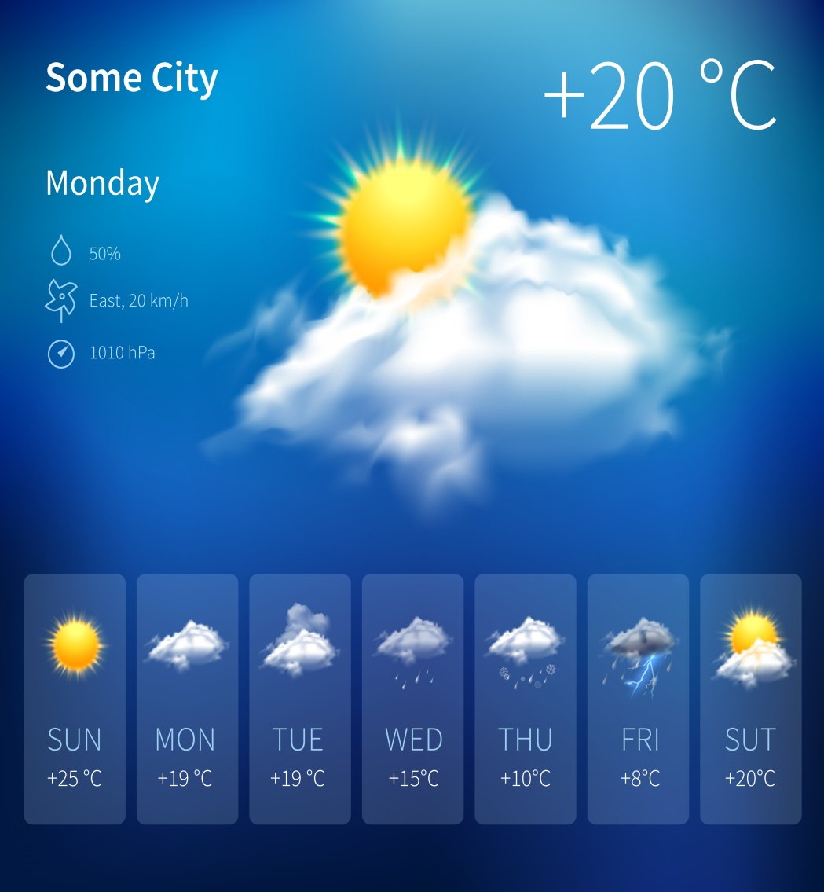
Objective
The objective of this project is to gather weather data through web scraping, clean and preprocess the data, conduct analysis to gain insights about weather patterns, and create a dashboard to visualize the findings.

Slide 4
OUR APPROACH FOR THE PROJECT
WEB SCRAPPING – RETRIEVING DATA FROM 1MG WEBSITE
DATA CLEANING USING PYTHON
VISUALIZING & ANALYZING THE CLEAN DATA USING POWER BI

Slide 5
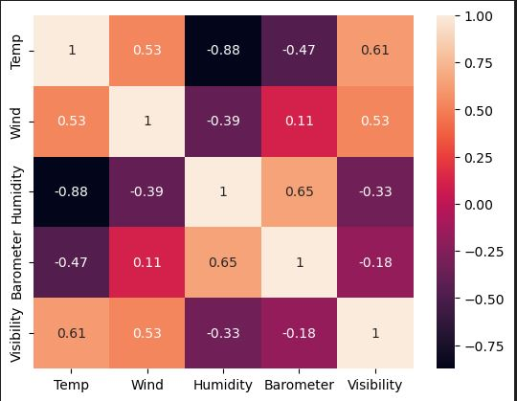
Co-relation Heatmap

Slide 6
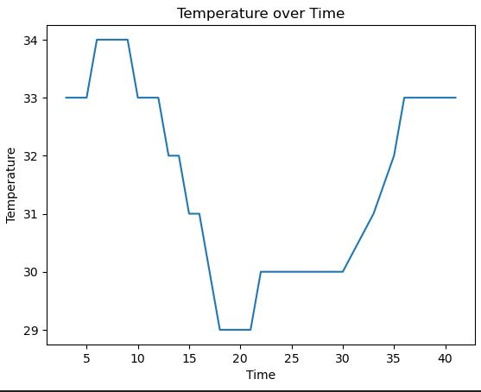
Temperature Over Time

Slide 7
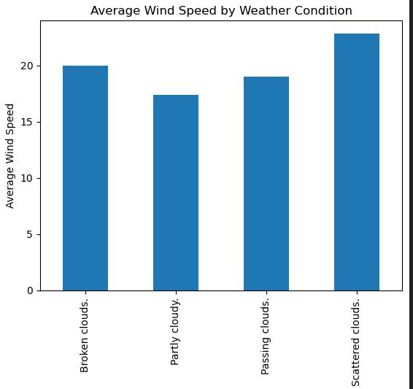
Average Wind Speed by Weather Condition

Slide 8
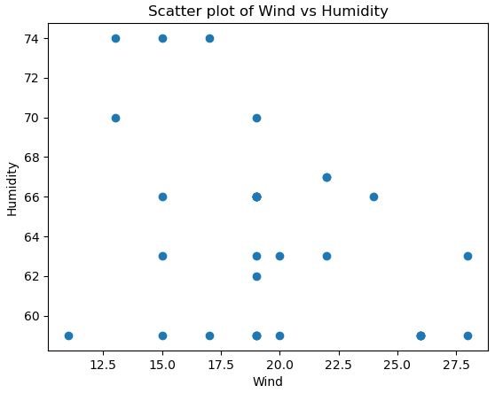
Scatter plot between Wind vs Humidity

Slide 9
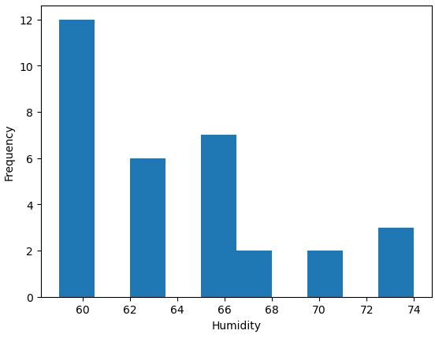
Humidity vs Frequecny

Slide 10
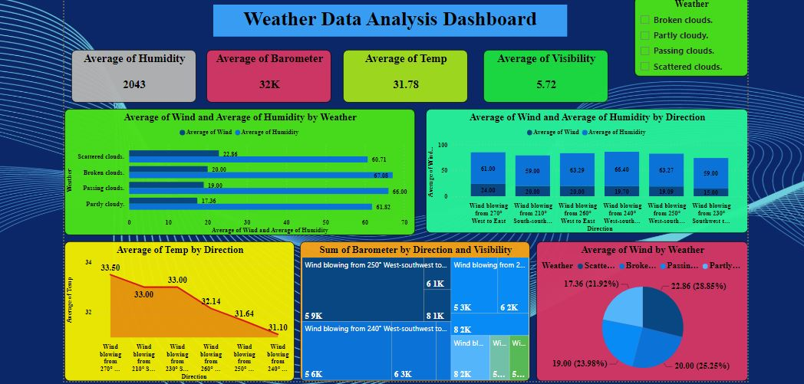

Slide 11
INSIGHTS
Average Humidity is 2043
Average barometer reading is 32k
Average temp found in the data set is 31.78
Average visibility is about 5.72km

Slide 12
Future Scope
Weather data analysis techniques will continue to advance, enabling more accurate weather forecasting. Machine learning and artificial intelligence algorithms will be leveraged to enhance prediction models, incorporating a wide range of data sources such as satellite imagery, weather station data, radar observations, and climate models. This will result in more precise and reliable weather forecasts, benefiting various sectors like agriculture, transportation, renewable energy, and disaster management.
With the increasing frequency and intensity of extreme weather events, analyzing their causes, patterns, and impacts becomes crucial. Weather data analysis will play a vital role in understanding and predicting events such as hurricanes, tornadoes, heatwaves, and floods. This knowledge can help in early warning systems, disaster preparedness, and proactive decision-making to mitigate the adverse effects of these events.
Climate change is a global challenge that requires a deep understanding of long-term weather patterns and trends. Weather data analysis will contribute to assessing climate change impacts, studying climate variability, and analyzing historical weather records. By examining temperature trends, precipitation patterns, and other climatic variables, scientists can better understand the dynamics of climate change and develop effective strategies for adaptation and mitigation.

Slide 13
THANK YOU

